Slide 1
HOTEL DATABASE MANAGEMENT SYSTEM
TEAM MEMBERS:
Akul Samrat - 002959056
Alekya Kastury - 001530235
Krishna Sai Pallela - 001524408
Muralikrishna Shanmuganathan - 001507146
Sai Mounika Gundapaneni - 002926655
Satya Sri Sowmya Chinimilli - 002102974

Slide 2
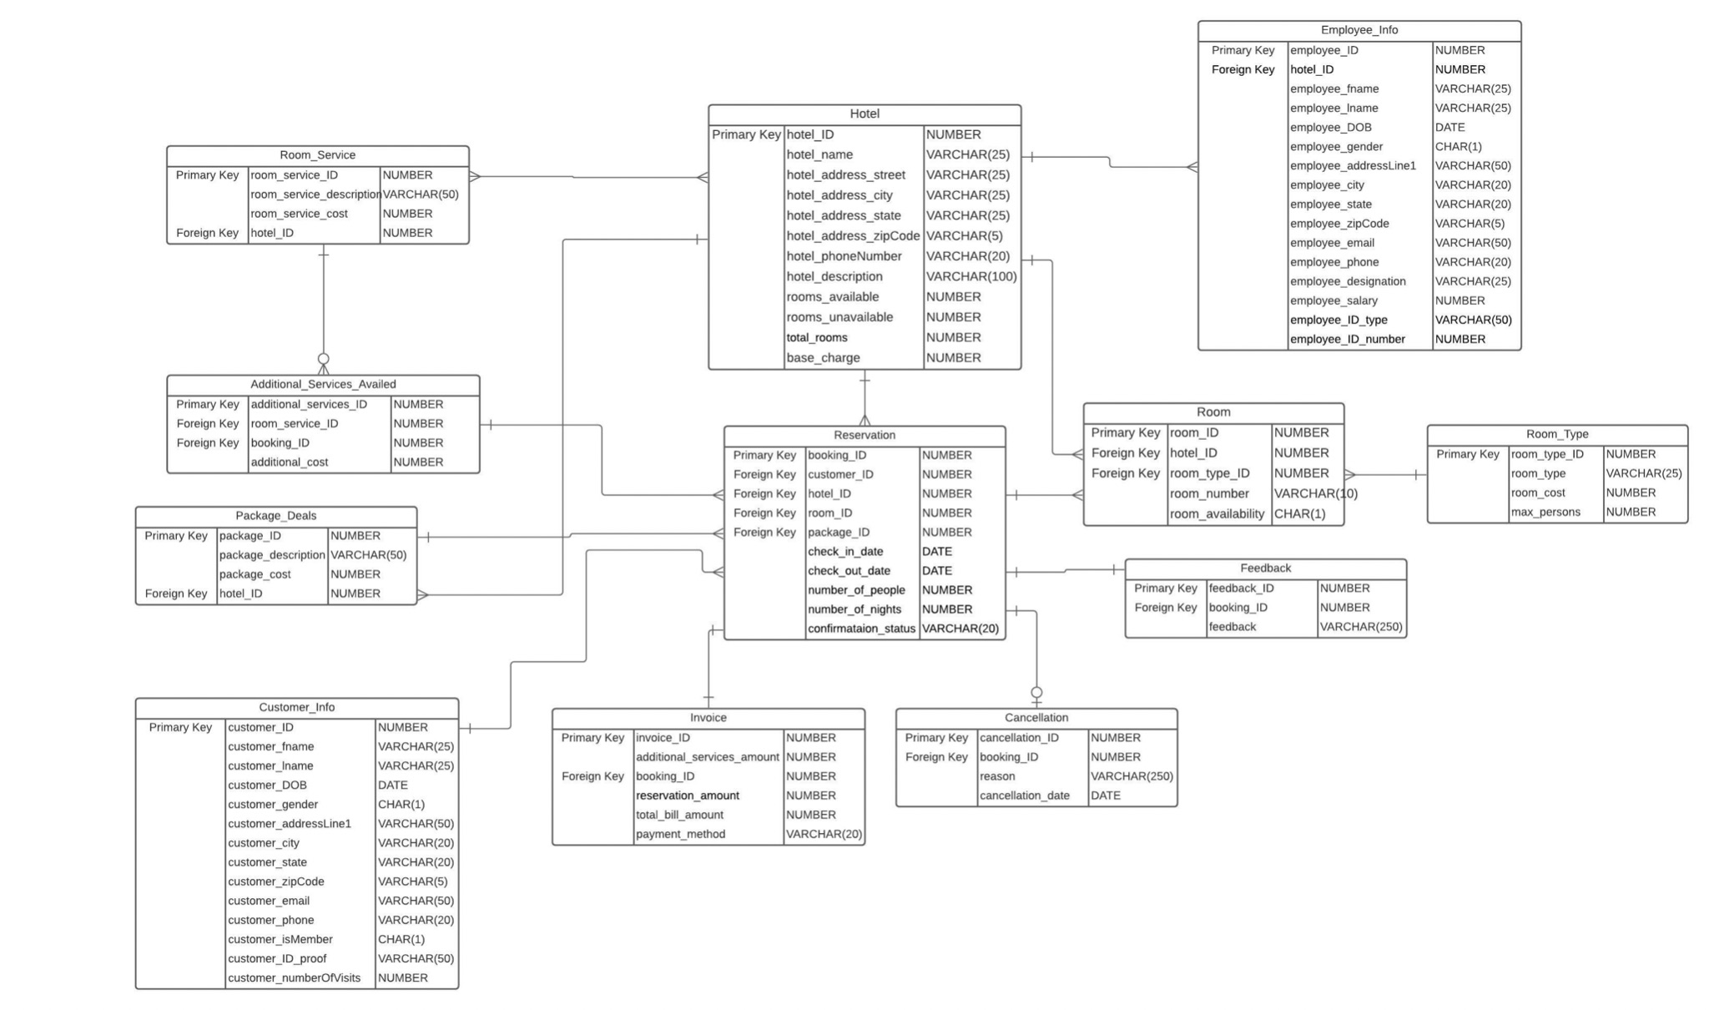
ER DIAGRAM

Slide 3
Features
Implemented using PL/SQL procedure driven approach
User Roles
Customized views for every user
Triggers
Indexes
Stored Procedures
Packages and Functions

Slide 4
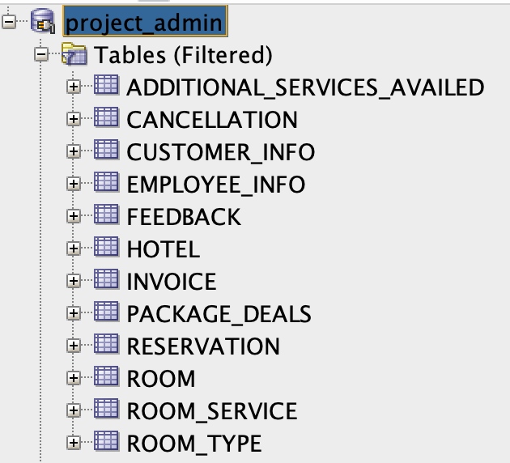
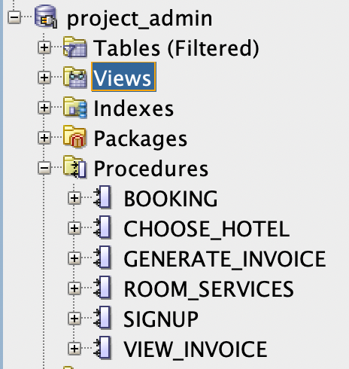
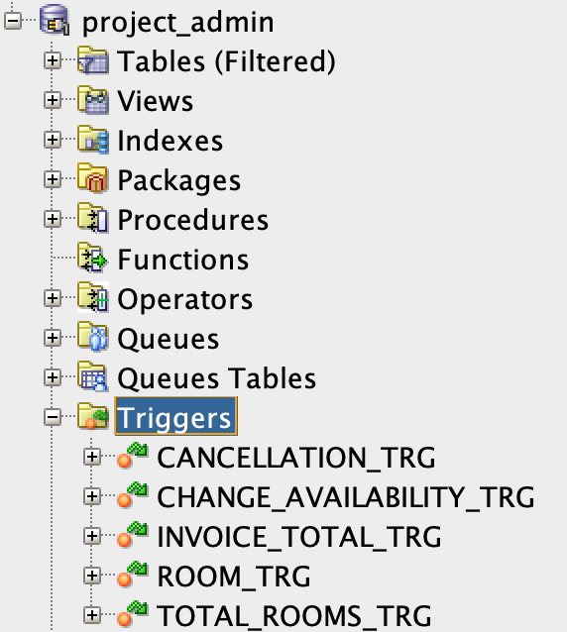
DATABASE OBJECTS

Slide 5
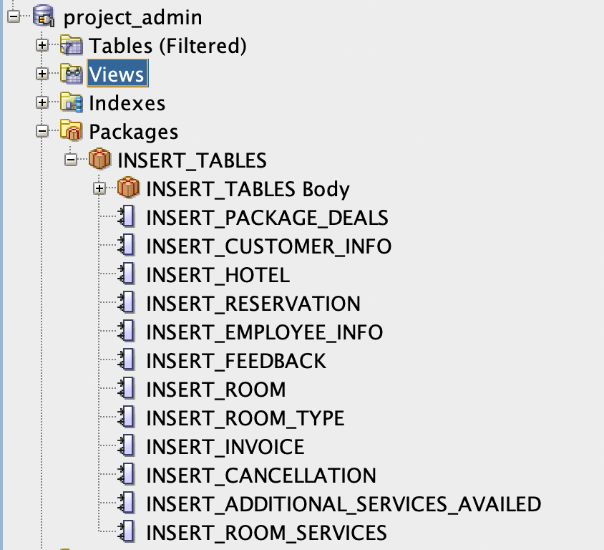
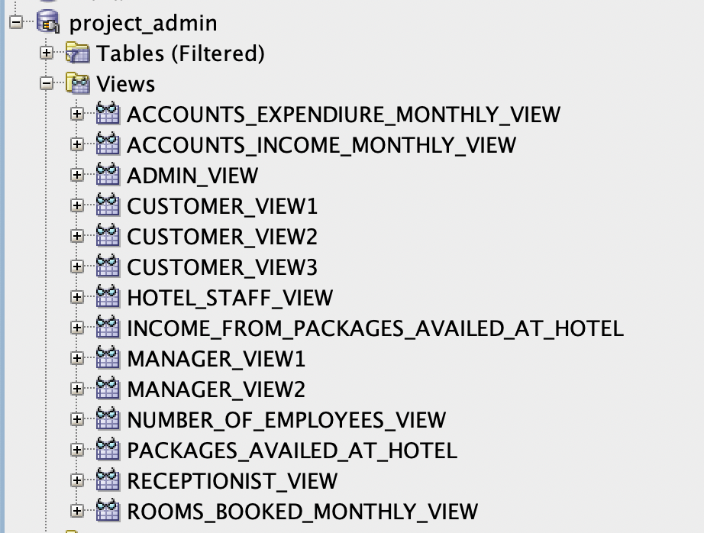
DATABASE OBJECTS

Slide 6
STEPS TO RUN THE CODE
Execute create_table_DDL.sql
Execute Create_Triggers.sql
Execute Create_Indexes.sql
Execute Insert_Values_Package.sql
Execute Insert_Values_Data.sql
Execute Create_Views.sql
Execute Create_roles_script.sql
Execute Customer_signup.sql
Execute Exec_customer_signup.sql
Connect to customer account and book hotels

Slide 7
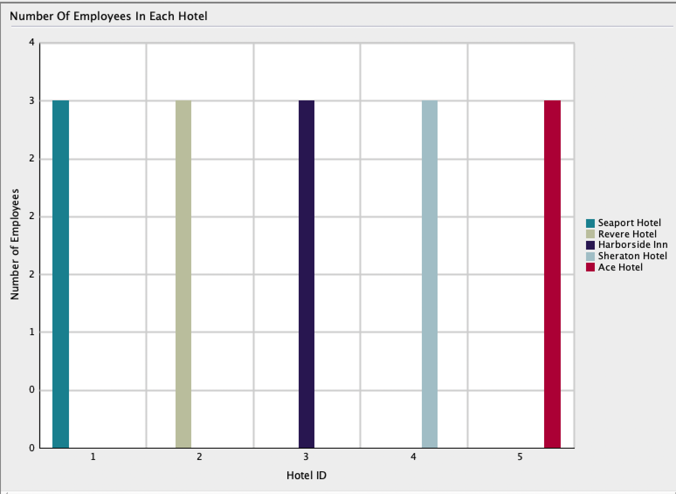
REPORT – 1 – Number of employees in Each hotel

Slide 8
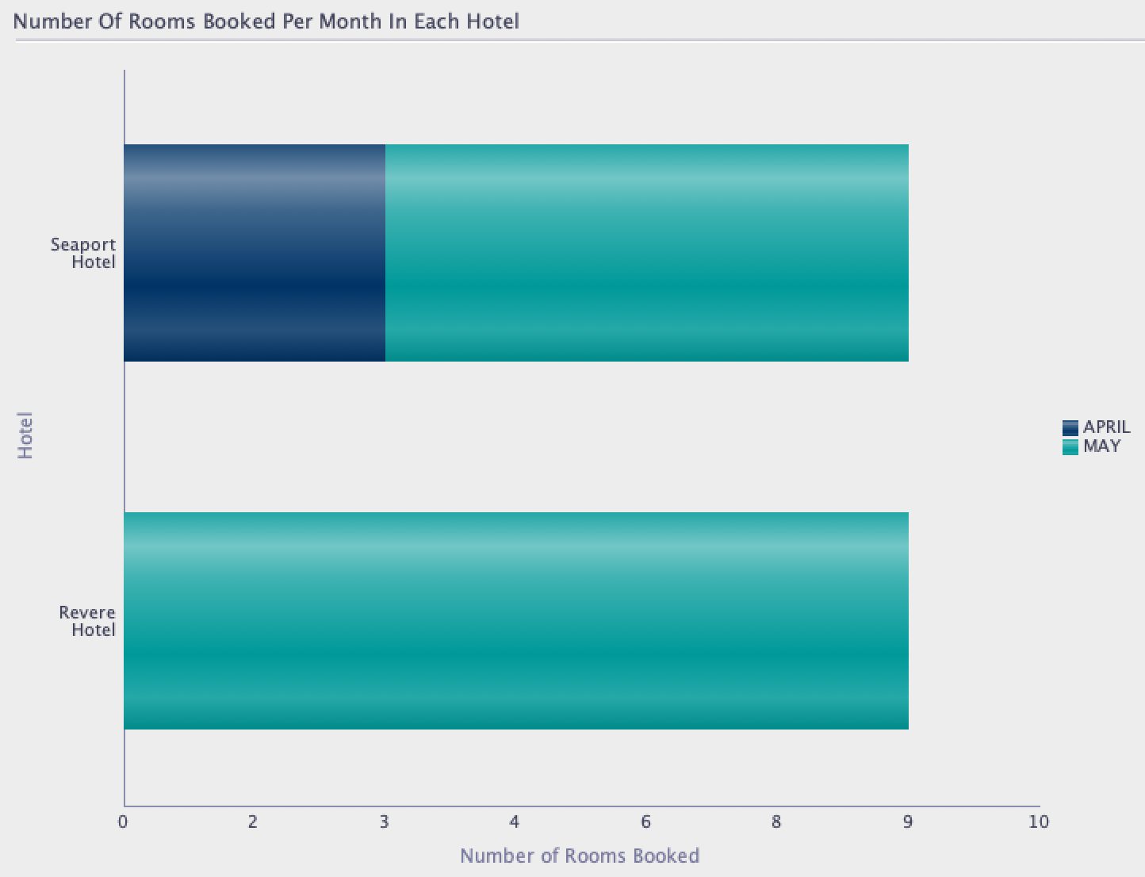
REPORT – 2 – Number of rooms booked per month in each hotel

Slide 9
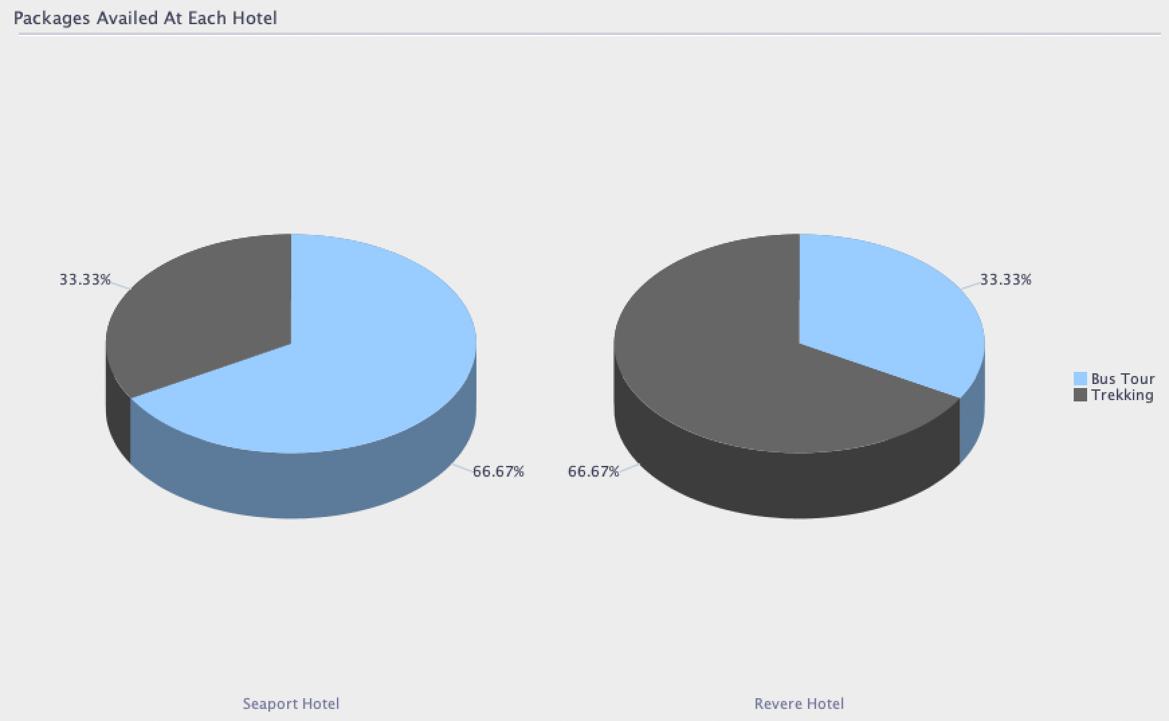
REPORT – 3 – Packages availed at each hotel

Slide 10
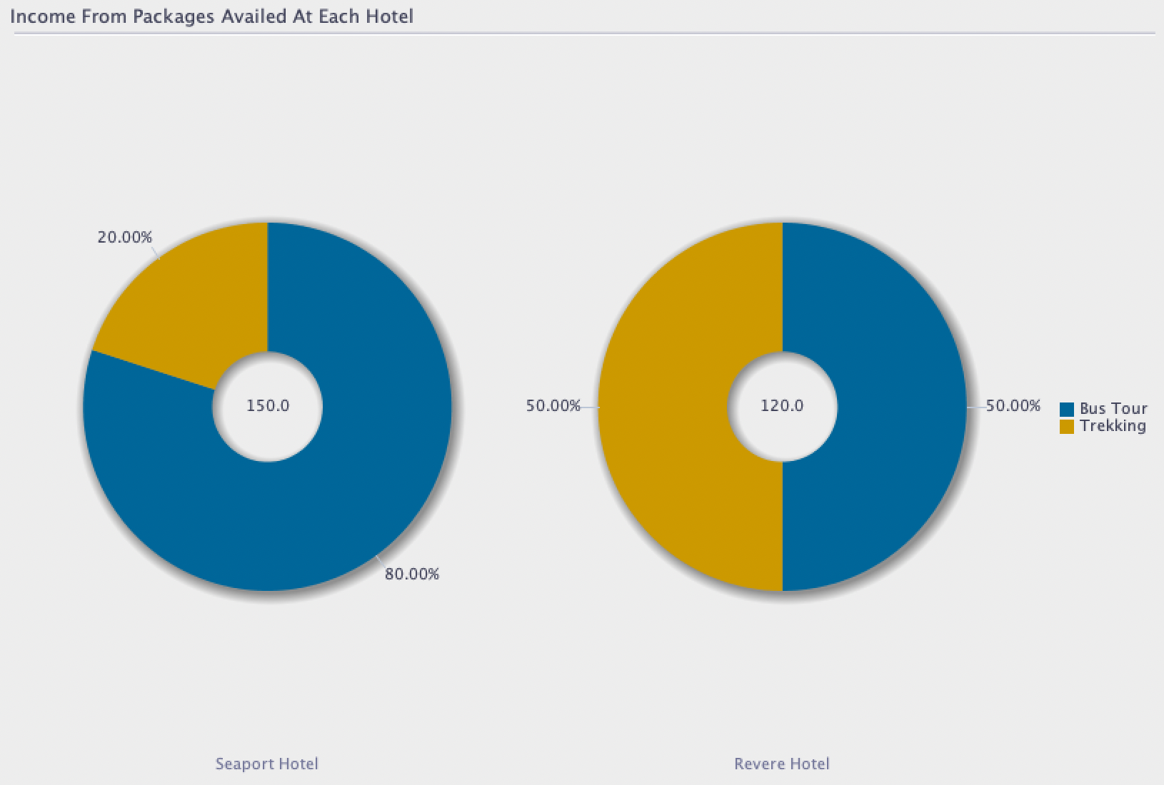
REPORT – 4 – Total income from Packages availed by customer

Slide 11
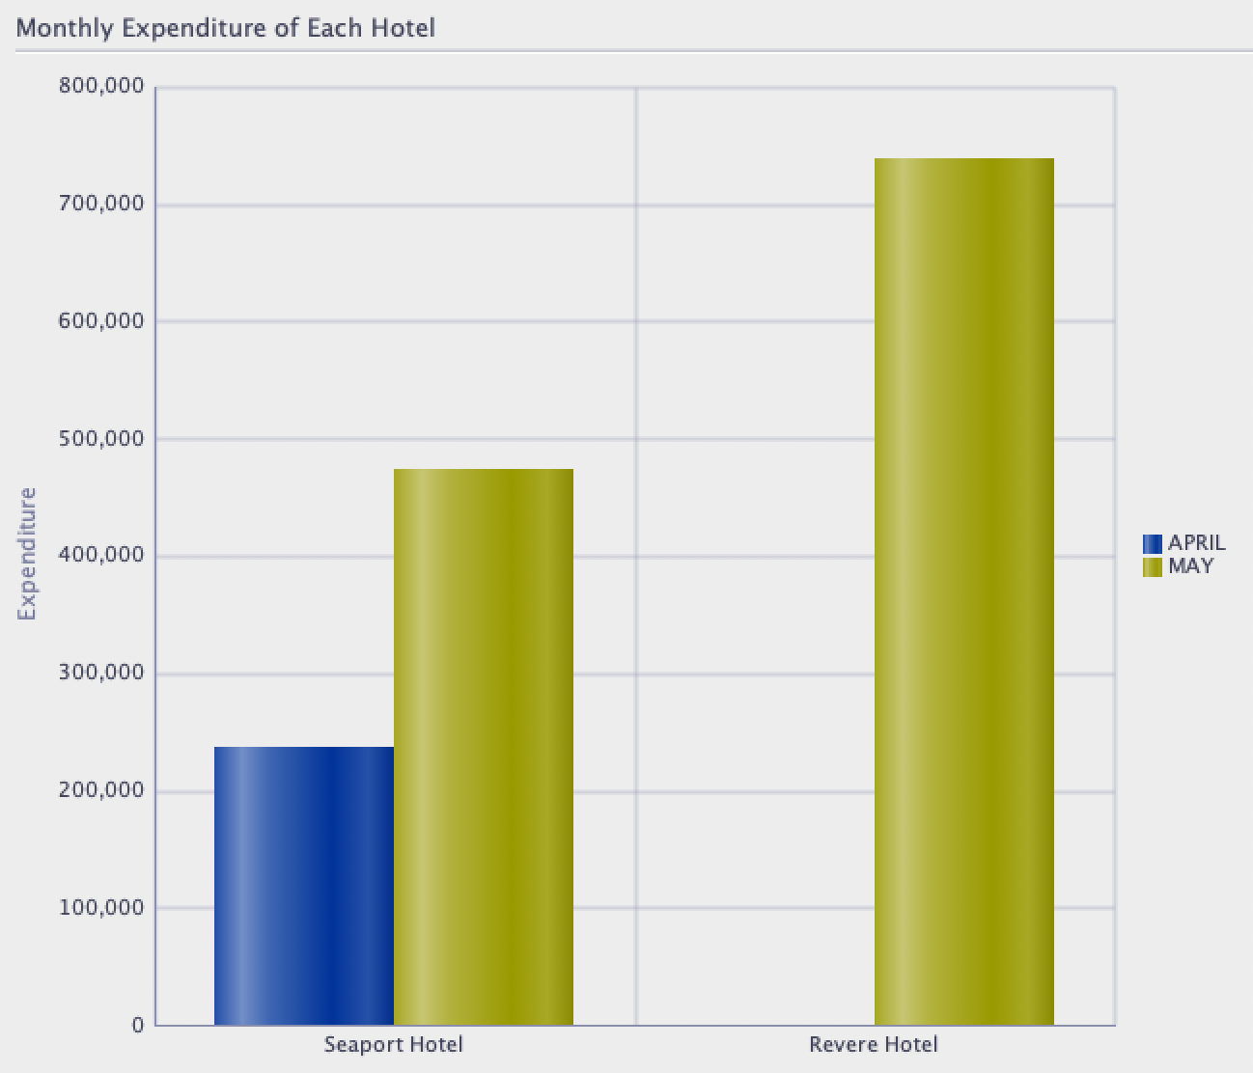
REPORT – 5 – Monthly expenditure of each hotel

Slide 12
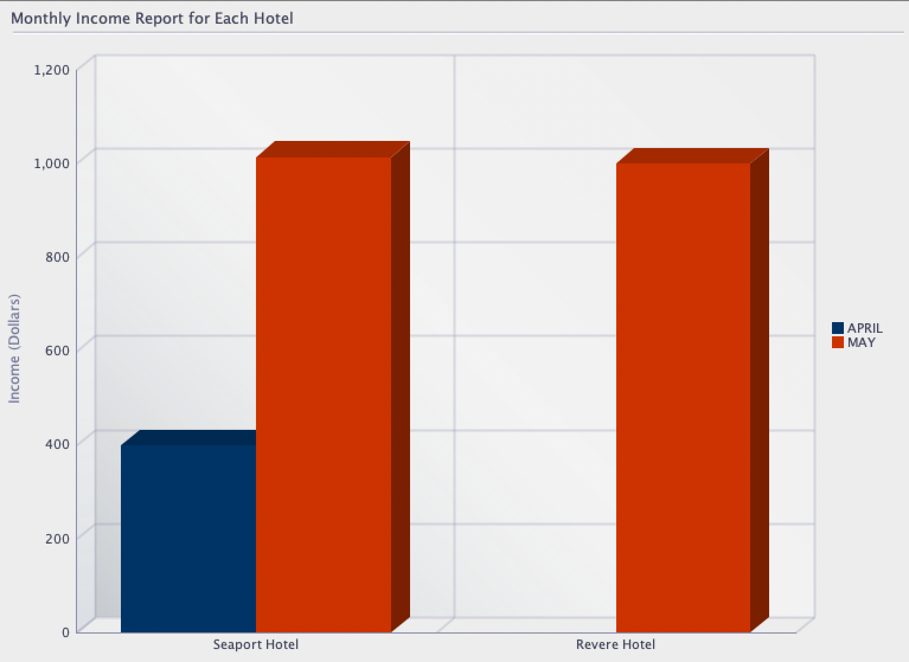
REPORT – 6 – Monthly income of each hotel

Slide 13
INDIVIDUAL CONTRIBUTIONS
Akul Samrat - DML, DDL, Views, Reports.
Alekya Kastury - DML, DDL, Triggers, Customer signup demo, Packages.
Krishna Sai Pallela - DML, DDL, Indexes, Packages.
Muralikrishna Shanmuganathan - DDL, User Roles, Customer signup demo, Packages.
Sai Mounika Gundapaneni - DML, DDL, Views, View all tables script, Reports.
Satya Sri Sowmya Chinimilli - DML, DDL, Views, Reports, Triggers.

Slide 14
THANK YOU!

